Slide 1
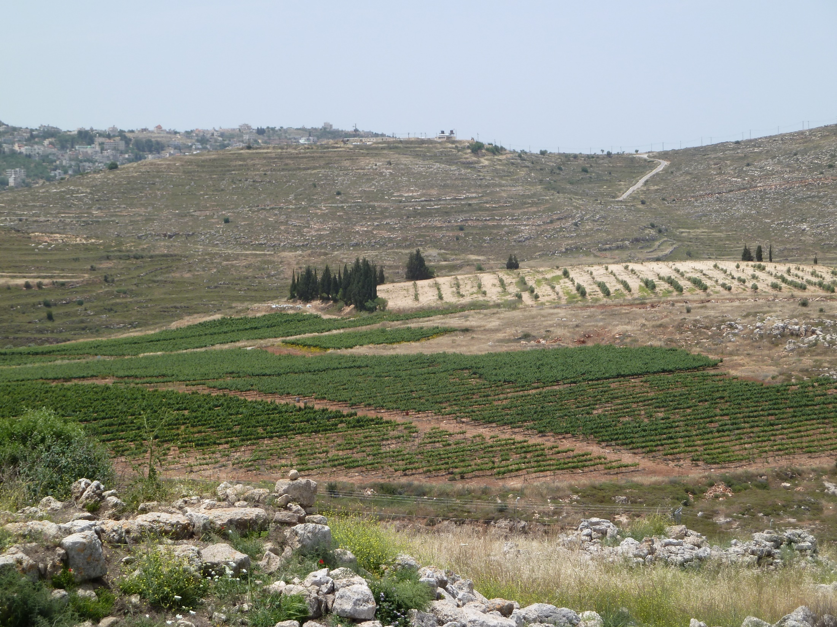
John 15.1-17 Vineyards near Shiloh in the
hill country of Ephraim in Israel

Slide 2
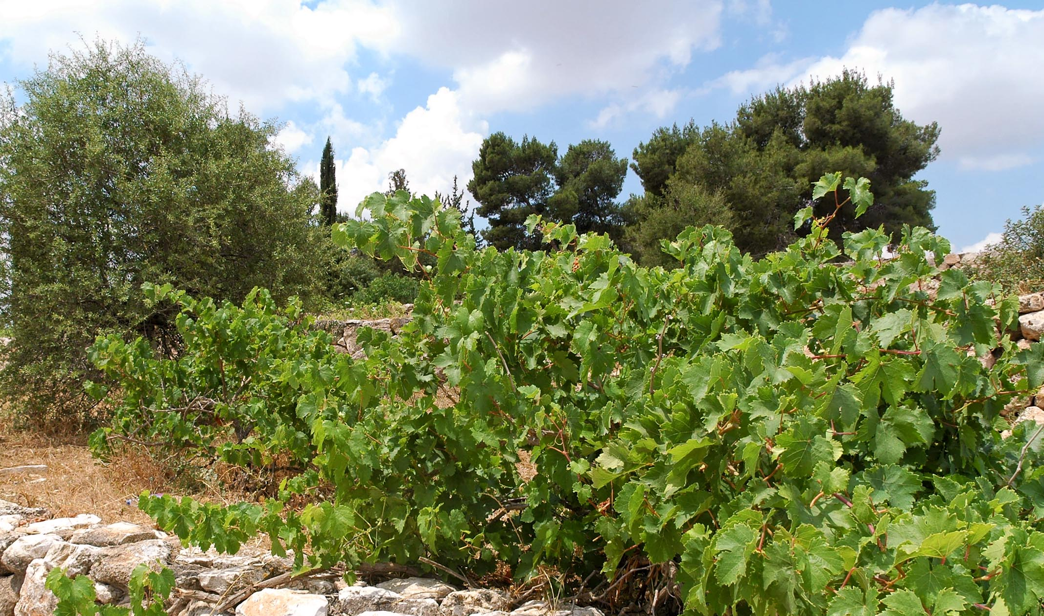
John 15.1-2 NET: “I am the true vine and my Father is the gardener. He takes away every branch that does not bear fruit in me. He prunes every branch that bears fruit so that it will bear more fruit.”
grape vine image © 2012 Todd Bolen / BiblePlaces.com

Slide 3
John 15.1-2 NET: “I am the true vine and my Father is the gardener. He takes away [αἴρει] every branch that does not bear fruit in me. He prunes [καθαίρει] every branch that bears fruit so that it will bear more fruit.”

Slide 4
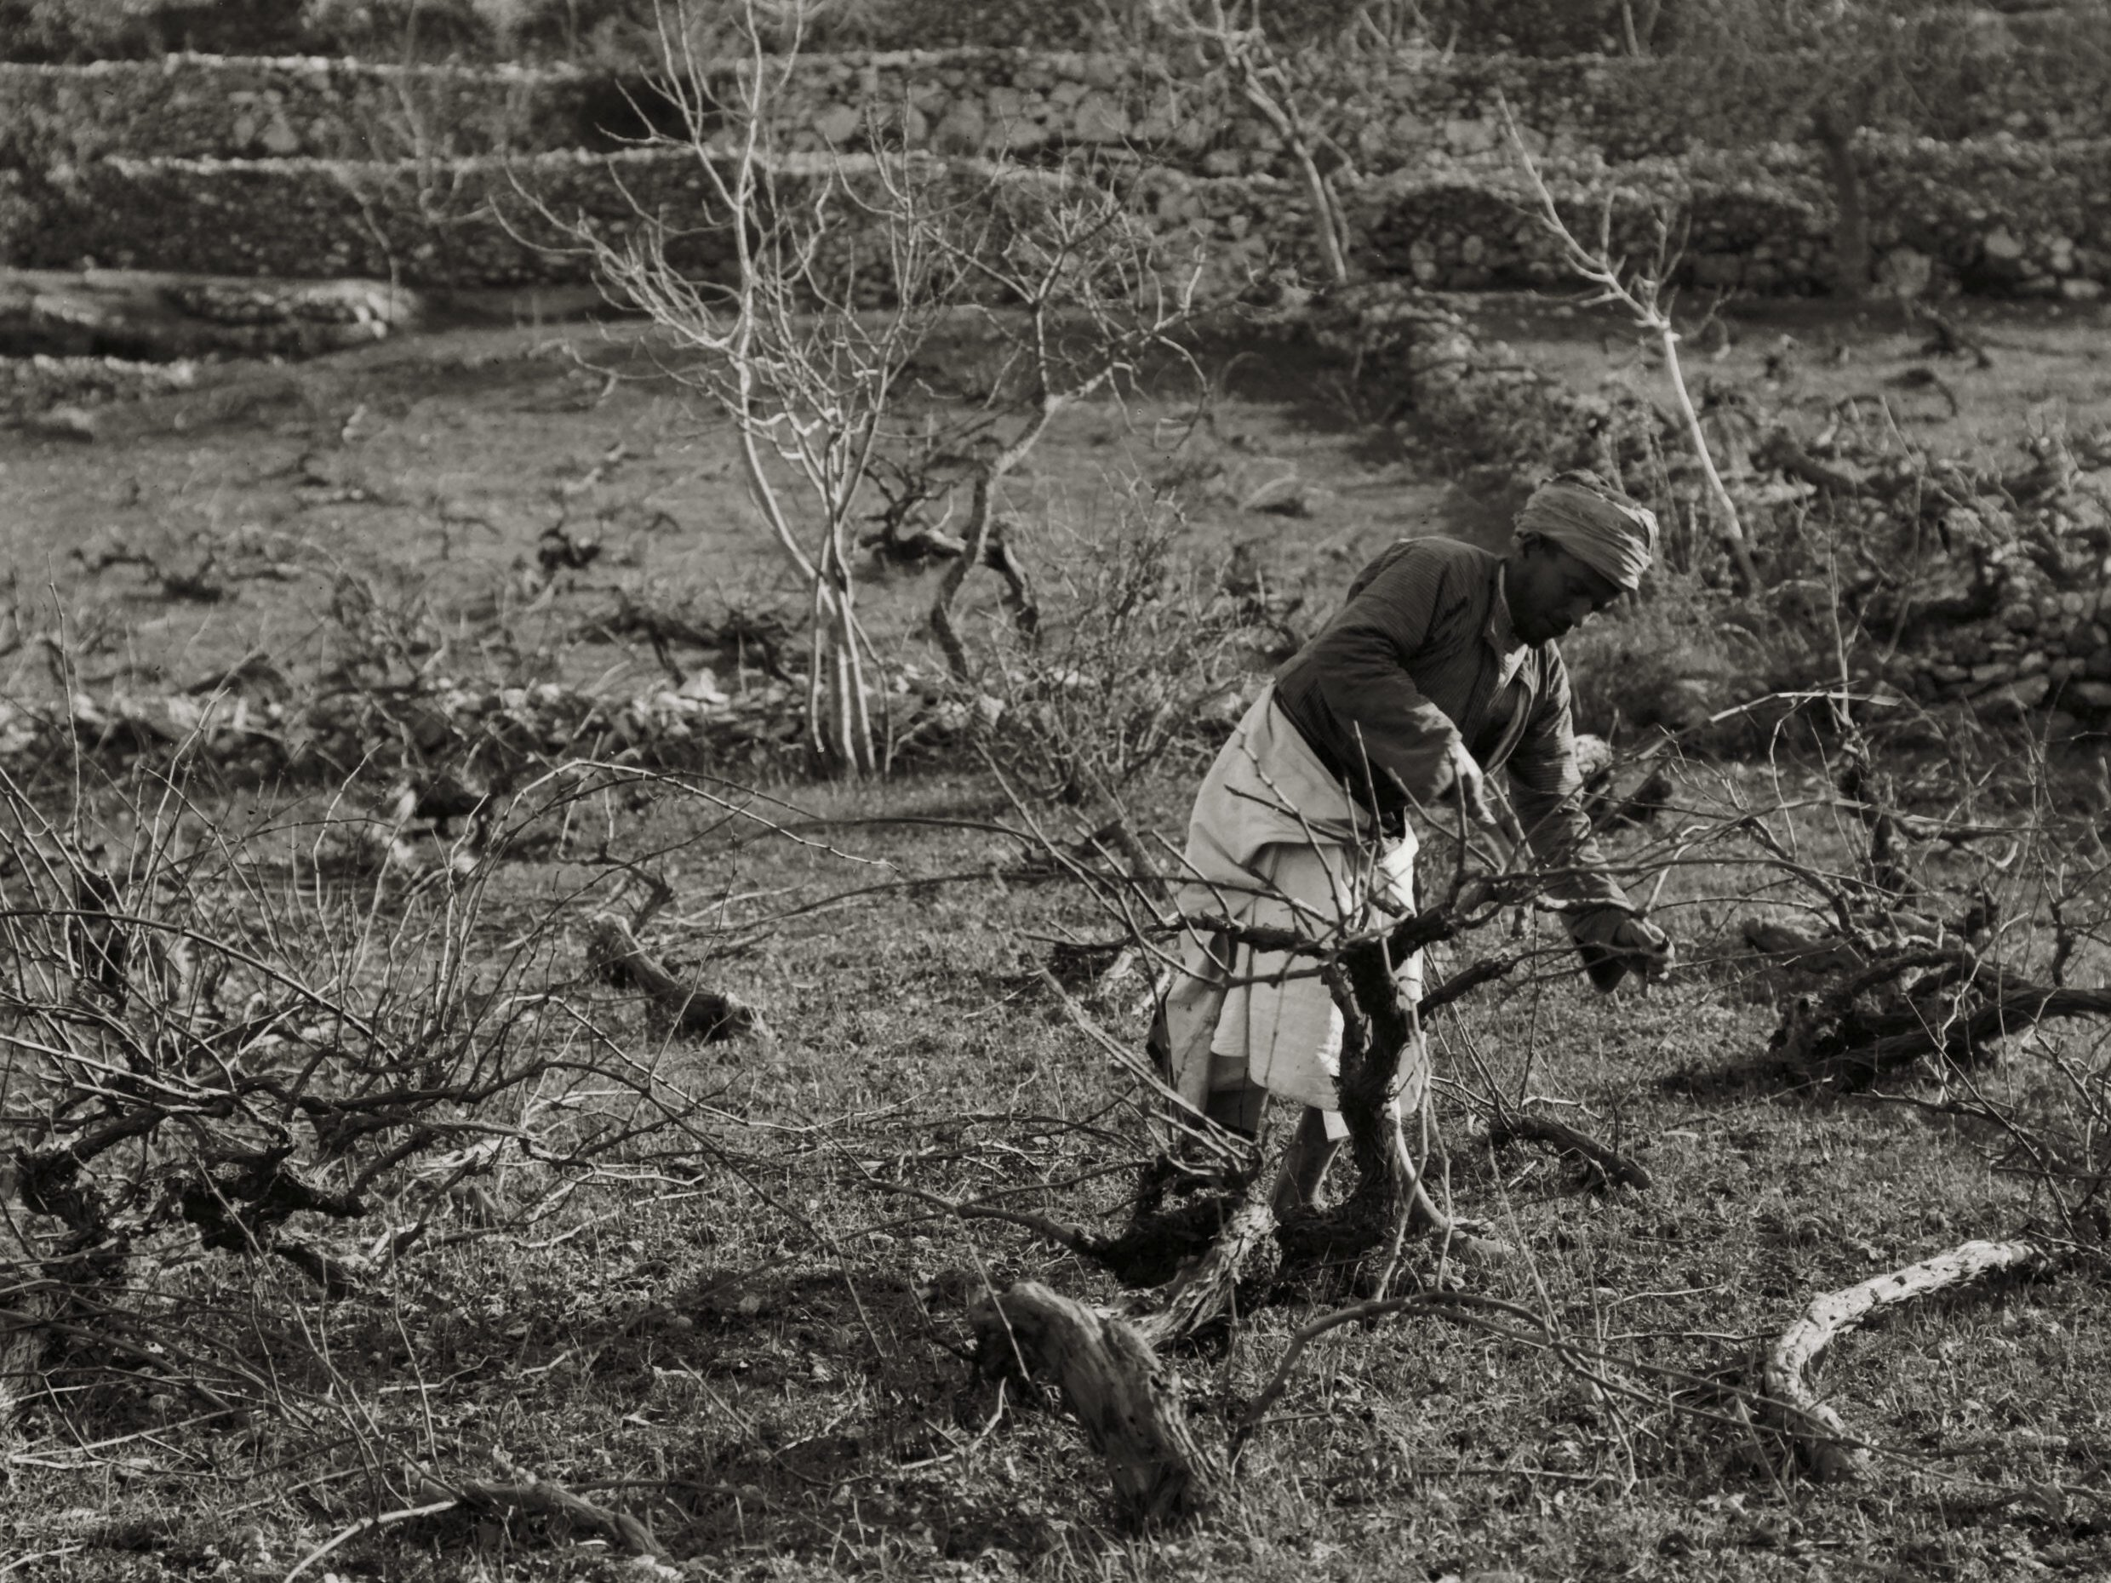
John 15.1-2 NET: “I am the true vine and my Father is the gardener. He takes away every branch that does not bear fruit in me. He prunes every branch that bears fruit so that it will bear more fruit.”
grape vines image from Eric Matson Collection
© 2009 Todd Bolen / LifeintheHolyLand.com

Slide 5
John 15.1-2 NET: “I am the true vine and my Father is the gardener. He takes away every branch that does not bear fruit in me. He prunes every branch that bears fruit so that it will bear more fruit.”

Slide 6
John 15.3-6: “You are clean already because of the word that I have spoken to you. Remain in me, and I will remain in you. Just as the branch cannot bear fruit by itself, unless it remains in the vine, so neither can you unless you remain in me. I am the vine; you are the branches. The one who remains in me– and I in him– bears much fruit, because apart from me you can accomplish nothing. If anyone does not remain in me, he is thrown out like a branch, and dries up; and such branches are gathered up and thrown into the fire, and are burned up.”

Slide 7
John 15.2b-3: “He prunes [καθαίρει] every branch that bears fruit so that it will bear more fruit. You are clean [καθαροί] already because of the word that I have spoken to you.”

Slide 8
John 15.4-5: “Remain in me, and I will remain in you.
“You must remain in me, and I in you.”
Just as the branch cannot bear fruit by itself, unless it remains in the vine, so neither can you unless you remain in me. I am the vine; you are the branches. The one who remains in me– and I in him– bears much fruit, because apart from me you can accomplish nothing.”

Slide 9
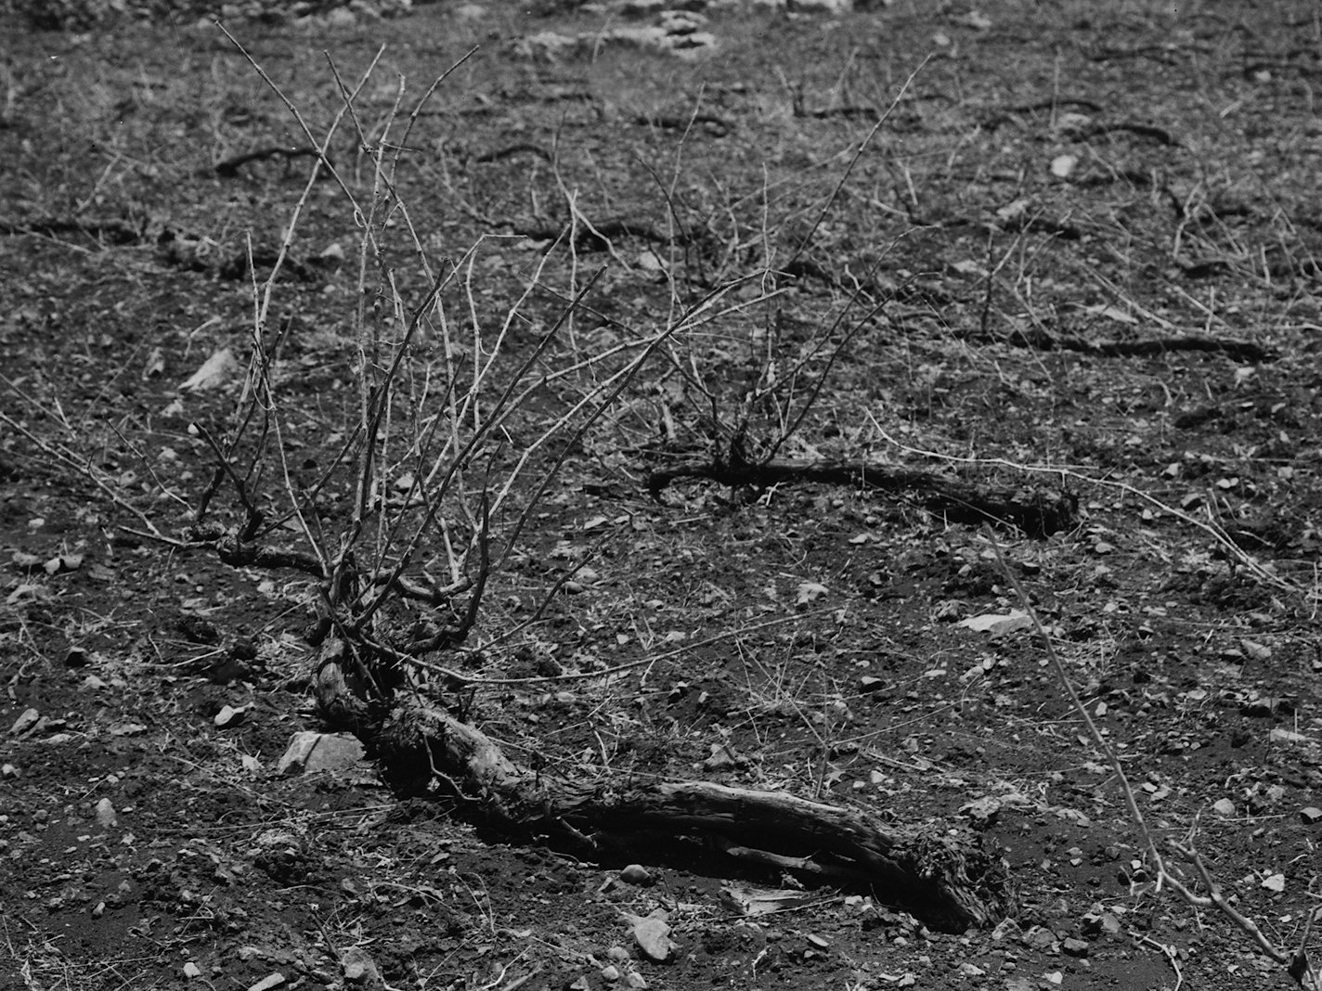
John 15.6: “If anyone does not remain in me, he is thrown out like a branch, and dries up; and such branches are gathered up and thrown into the fire, and are burned up.”

Slide 10
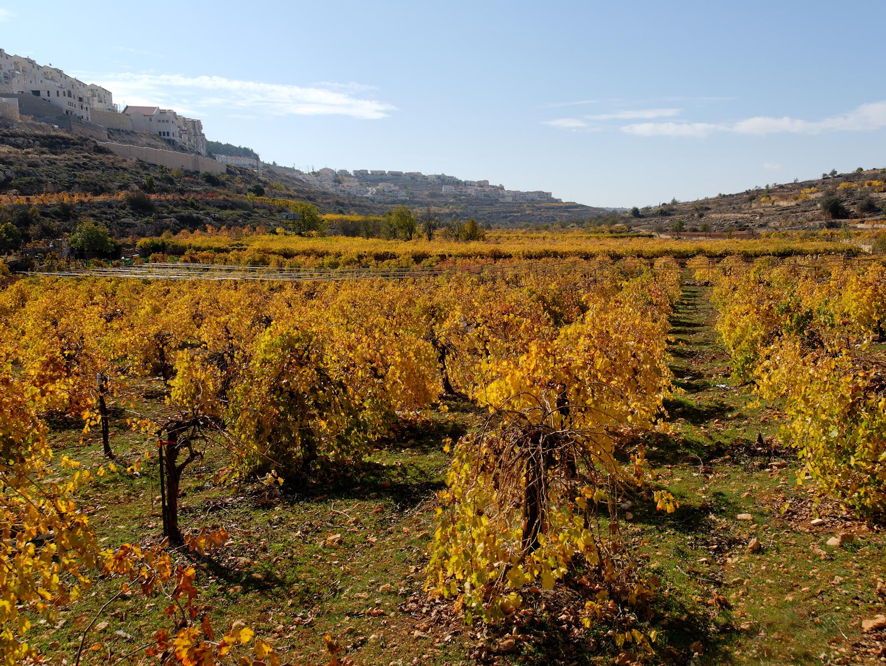
John 15.7-8: “If you remain in me and my words remain in you, ask whatever you want, and it will be done for you. My Father is honored by this, that you bear much fruit and show that you are my disciples.”
grape vines image © 2012 Todd Bolen / BiblePlaces.com

Slide 11
John 15.7-8: “If you remain in me and my words remain in you, ask whatever you want, and it will be done for you. My Father is honored by this, that you bear much fruit and show that you are my disciples.”

Slide 12
John 15.7-8: “If you remain in me and my words remain in you, ask whatever you want, and it will be done for you. My Father is honored by this, that you bear much fruit and show that you are my disciples.”

Slide 13
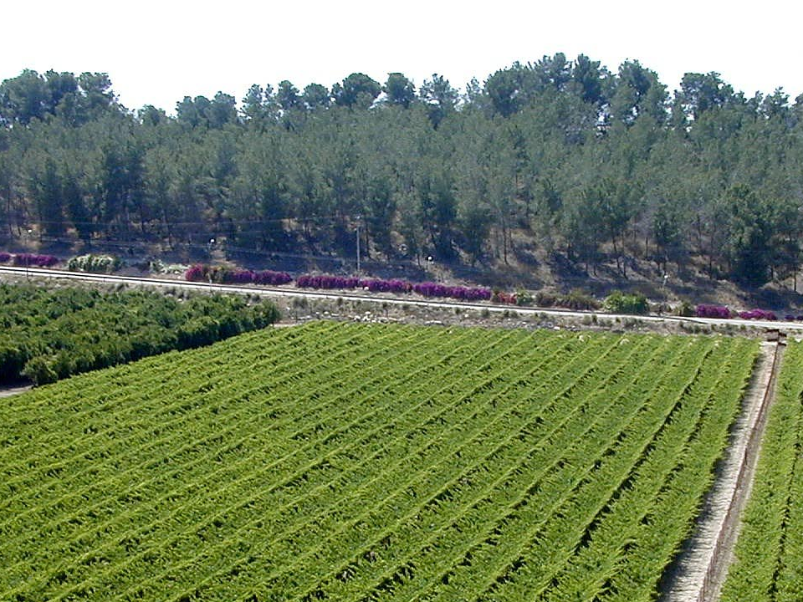
John 15.9-11: “Just as the Father has loved me, I have also loved you; remain in my love. If you obey my commandments, you will remain in my love, just as I have obeyed my Father's commandments and remain in his love. I have told you these things so that my joy may be in you, and your joy may be complete.”
grape vines image © 2012 Todd Bolen / BiblePlaces.com

Slide 14
John 15.9-11: “Just as the Father has loved me, I have also loved you; remain in my love. If you obey my commandments, you will remain in my love, just as I have obeyed my Father's commandments and remain in his love. I have told you these things so that my joy may be in you, and your joy may be complete.”

Slide 15
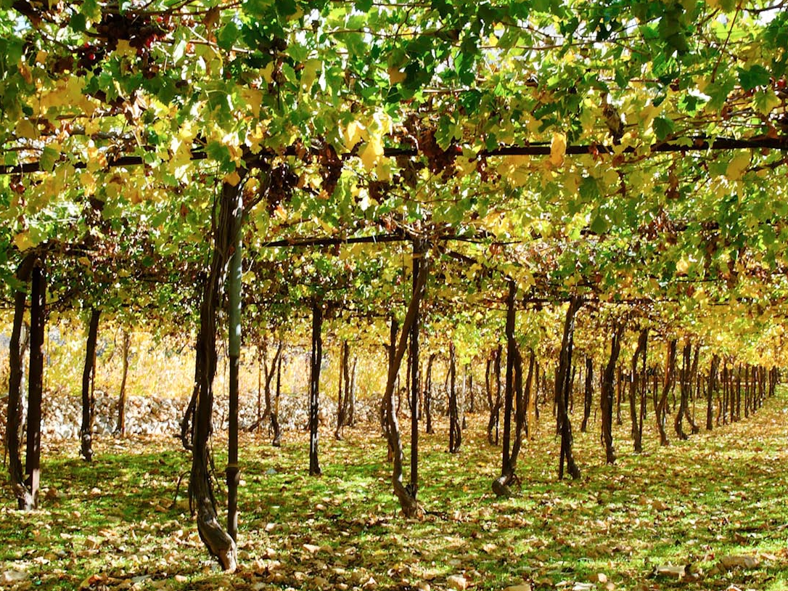
John 15.12-13: “My commandment is this– to love one another just as I have loved you. No one has greater love than this– that one lays down his life for his friends.”
grape vines image © 2012 Todd Bolen / BiblePlaces.com

Slide 16
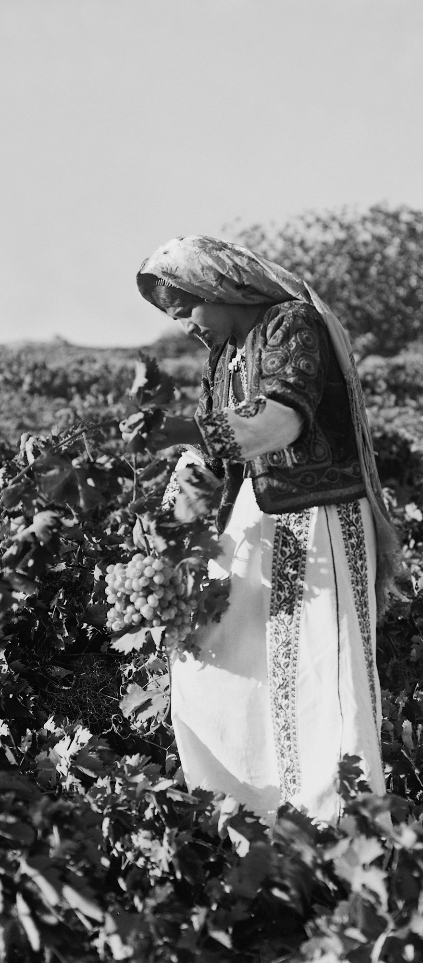
Eric Matson Collection; © 2009 Todd Bolen/LifeintheHolyLand.com
John 15.14-17: “You are my friends if you do what I command you. I no longer call you slaves, because the slave does not understand what his master is doing. But I have called you friends, because I have revealed to you everything I heard from my Father. You did not choose me, but I chose you and appointed you to go and bear fruit, fruit that remains, so that whatever you ask the Father in my name he will give you. This I command you– to love one another.”

Slide 17
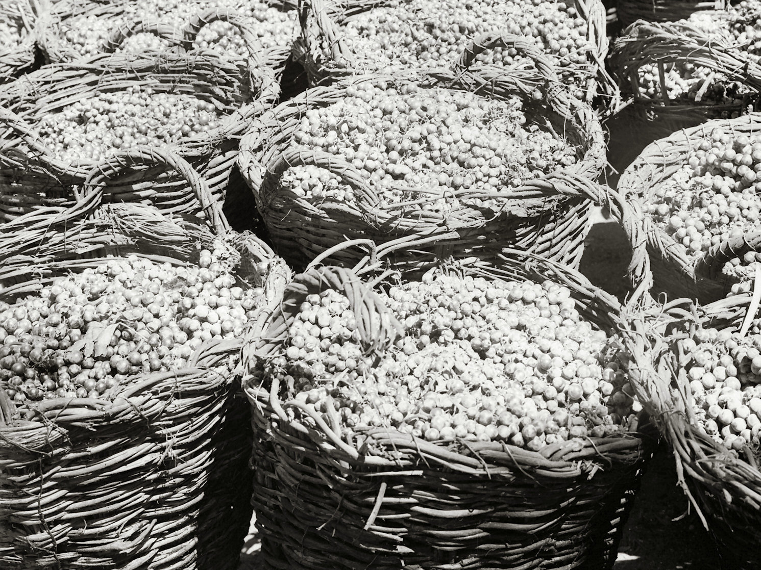
John 15.16-17: “You did not choose me, but I chose you and appointed you to go and bear fruit, fruit that remains, so that whatever you ask the Father in my name he will give you. This I command you– to love one another.”
grapes image from Eric Matson Collection
© 2009 Todd Bolen / LifeintheHolyLand.com

Slide 18
Reflect God’s character
share God’s values, ethics, priorities
Represent God
live like Christ, ministering to others
Fulfill obligations to God
obey the commands of Christ
share gospel, edify and love one another

Slide 19
Jesus was fruitful through…
Perfect love for God the Father
Perfect obedience to God the Father
Loving others sacrificially
Living sacrificially for gospel mission
Willing to die for others and mission

Slide 20
Believe in Christ
Love Christ Obey Christ = Fruit
Love one another as Christ loves us = Fruit
Pursue gospel mission
Pray in Christ’s name
Succeed in mission = Fruit

Slide 21
John 15.1-17 Vineyards near Shiloh in the
hill country of Ephraim in Israel

